Slide 1
Lecture 12: Perceptron and Back Propagation

Slide 2
Outline
Review of Classification and Logistic Regression
Introduction to Optimization
Gradient Descent
Stochastic Gradient Descent
Single Neuron Network (‘Perceptron’)
Multi-Layer Perceptron
Back Propagation

Slide 3
Outline
Review of Classification and Logistic Regression
Introduction to Optimization
Gradient Descent
Stochastic Gradient Descent
Single Neuron Network (‘Perceptron’)
Multi-Layer Perceptron
Back Propagation

Slide 4
Classification and Logistic Regression

Slide 5
Classification
Methods that are centered around modeling and prediction of a quantitative response variable (ex, number of taxi pickups, number of bike rentals, etc) are called regressions (and Ridge, LASSO, etc).
When the response variable is categorical, then the problem is no longer called a regression problem but is instead labeled as a classification problem.
The goal is to attempt to classify each observation into a category (aka, class or cluster) defined by Y, based on a set of predictor variables X.

Slide 6
Heart Data
response variable Y
is Yes/No
Age | Sex | ChestPain | RestBP | Chol | Fbs | RestECG | MaxHR | ExAng | Oldpeak | Slope | Ca | Thal | AHD
63 | 1 | typical | 145 | 233 | 1 | 2 | 150 | 0 | 2.3 | 3 | 0.0 | fixed | No
67 | 1 | asymptomatic | 160 | 286 | 0 | 2 | 108 | 1 | 1.5 | 2 | 3.0 | normal | Yes
67 | 1 | asymptomatic | 120 | 229 | 0 | 2 | 129 | 1 | 2.6 | 2 | 2.0 | reversable | Yes
37 | 1 | nonanginal | 130 | 250 | 0 | 0 | 187 | 0 | 3.5 | 3 | 0.0 | normal | No
41 | 0 | nontypical | 130 | 204 | 0 | 2 | 172 | 0 | 1.4 | 1 | 0.0 | normal | No

Slide 7
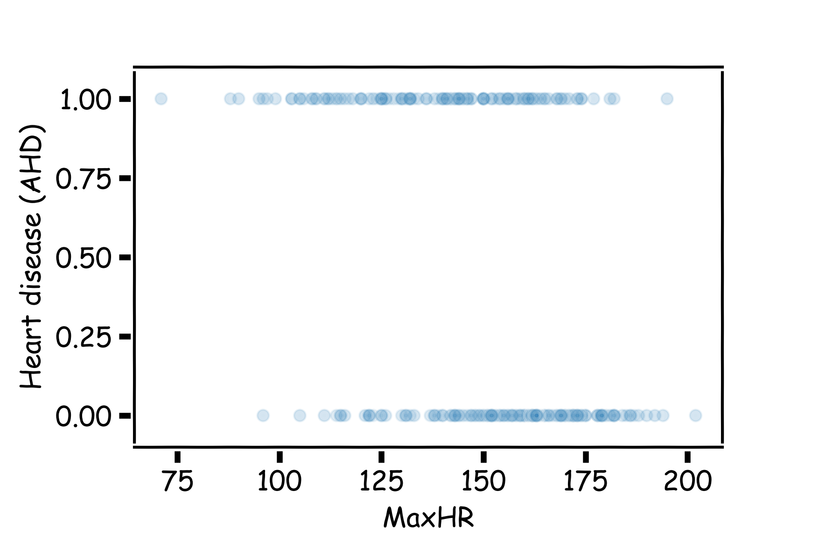
Heart Data: logistic estimation
We'd like to predict whether or not a person has a heart disease. And we'd like to make this prediction, for now, just based on the MaxHR.

Slide 8
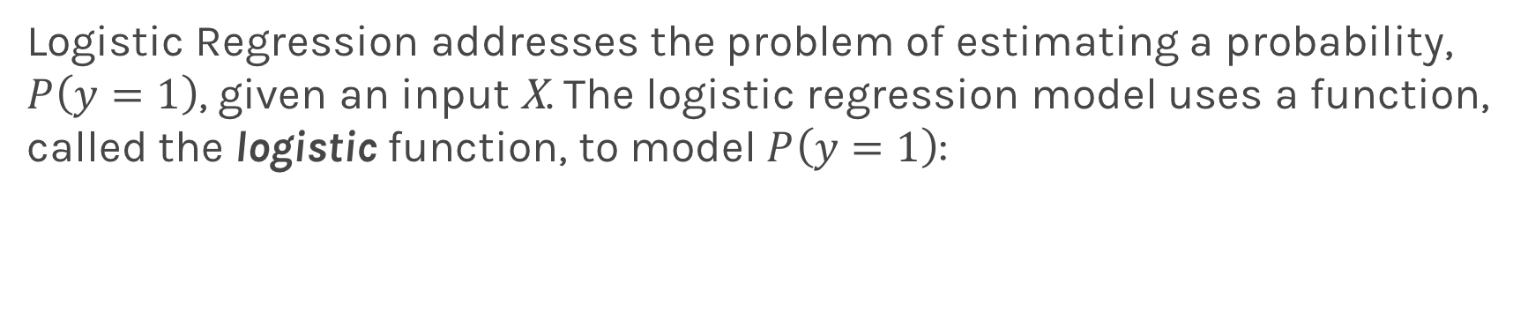
Logistic Regression
Logistic Regression addresses the problem of estimating a probability, $P\left(y=1\right)$, given an input X. The logistic regression model uses a function, called the logistic function, to model $P\left(y=1\right)$:

Slide 9
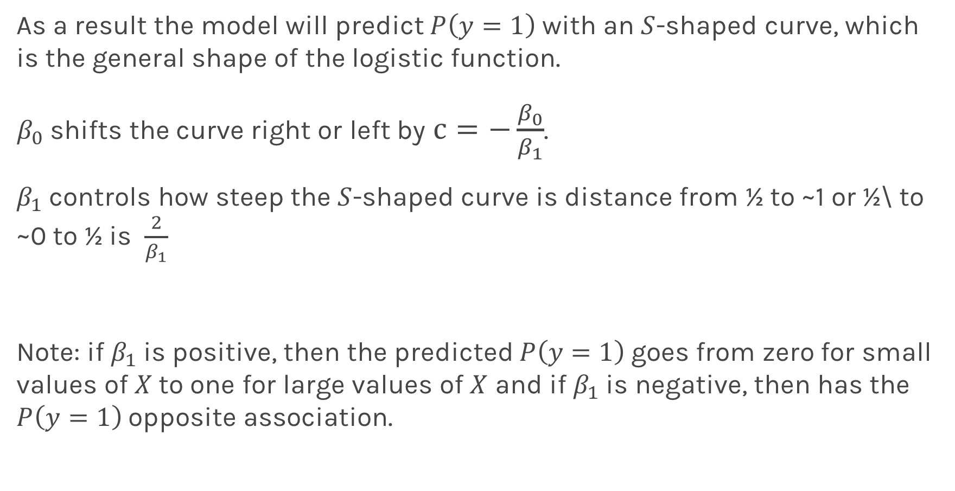
Logistic Regression
As a result the model will predict $P\left(y=1\right)$ with an $S$-shaped curve, which is the general shape of the logistic function.
$β_{0}$ shifts the curve right or left by $c=−\frac{β_{0}}{β_{1}}$.
$β_{1}$controls how steep the $S$-shaped curve is distance from ½ to ~1 or ½\ to ~0 to ½ is $\frac{2}{β_{1}}$
Note: if $β_{1}$is positive, then the predicted $P\left(y=1\right)$goes from zero for small values of $X$to one for large values of $X$ and if $β_{1}$is negative, then has the $P\left(y=1\right)$opposite association.

Slide 10
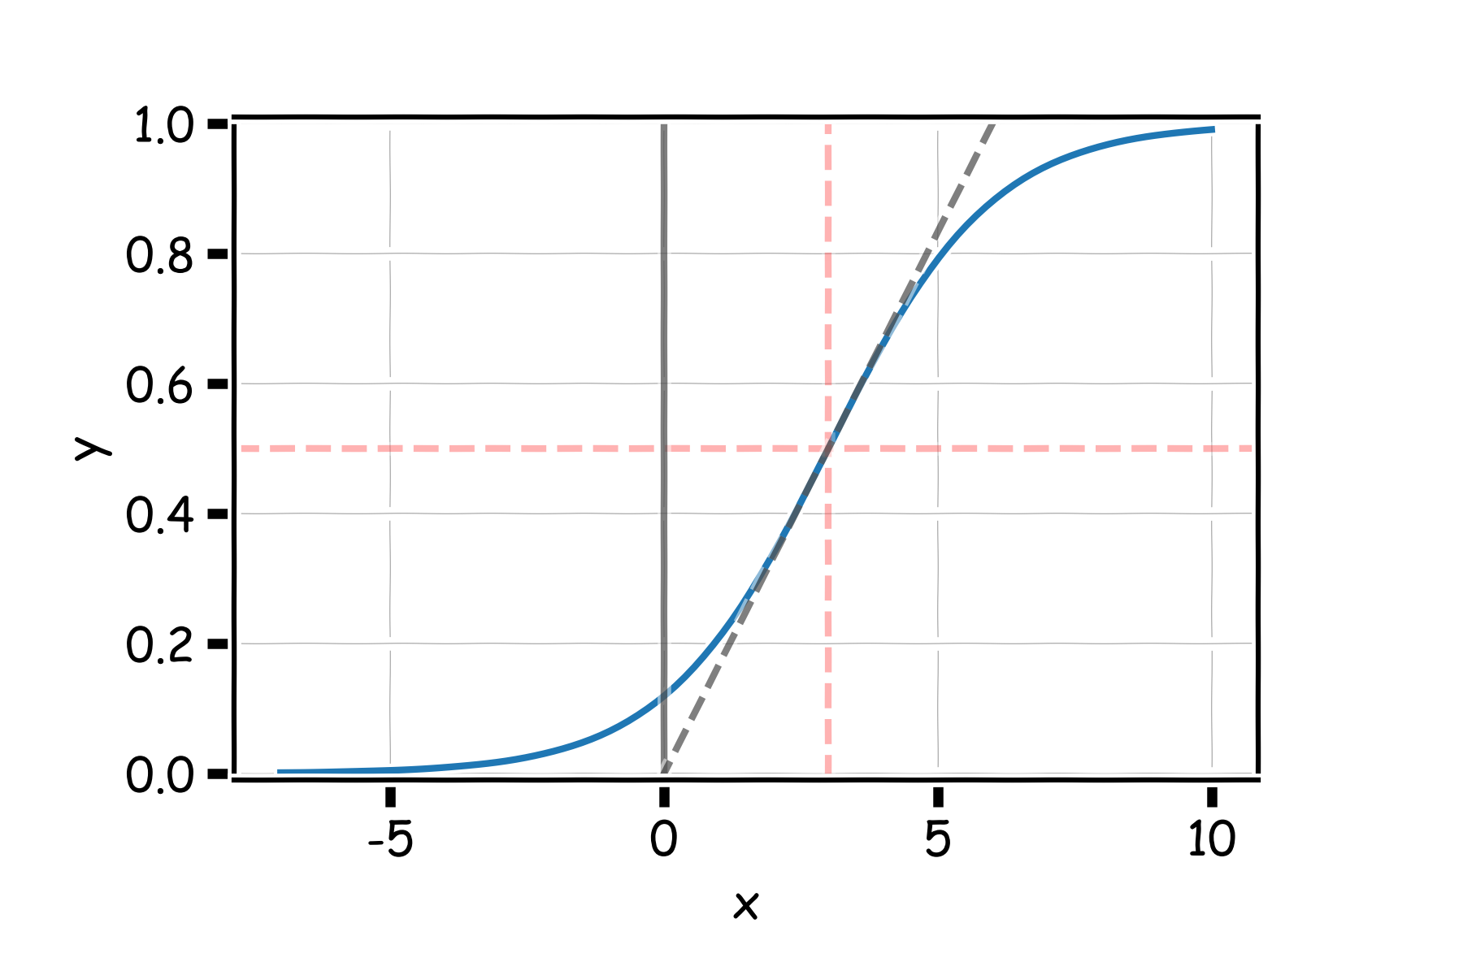
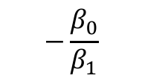
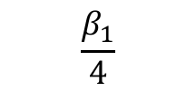

Logistic Regression
$$2β_{1}$$
$$−\frac{β_{0}}{β_{1}}$$
$$\frac{β_{1}}{4}$$

Slide 11
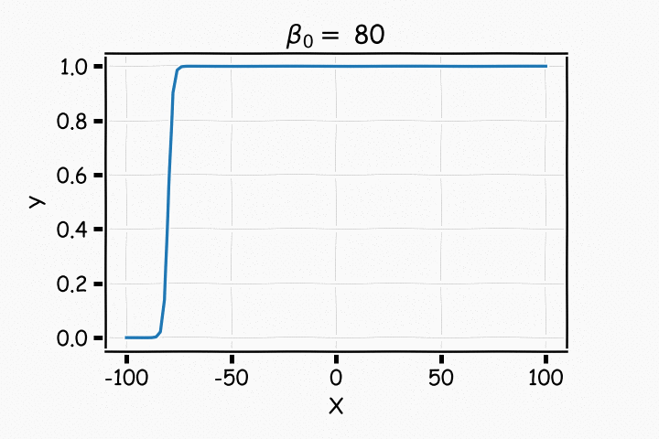
Logistic Regression

Slide 12
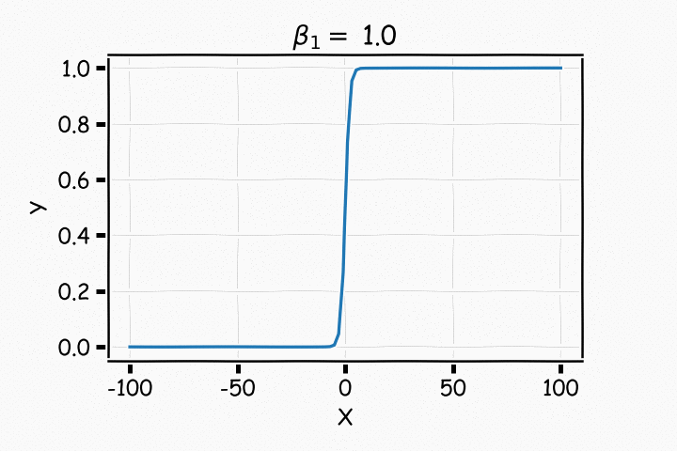
Logistic Regression

Slide 13
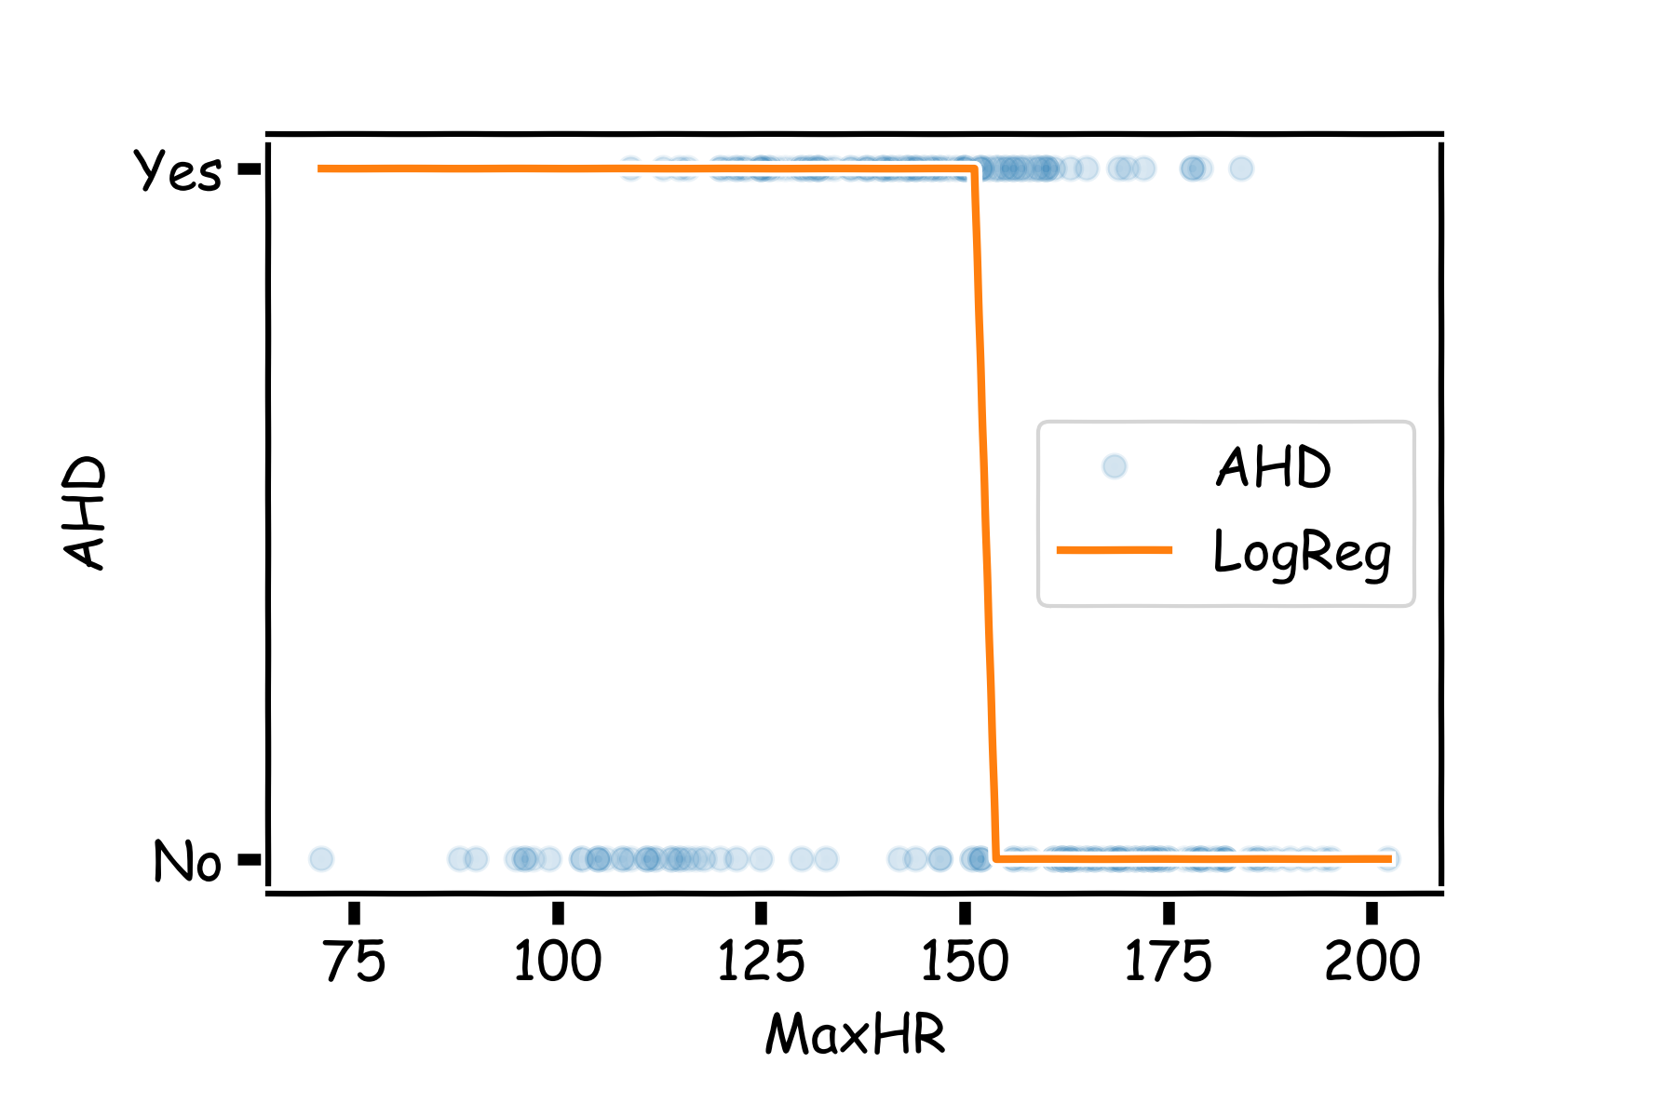
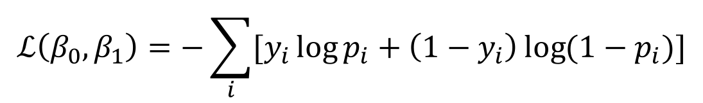
Estimating the coefficients for Logistic Regression
Find the coefficients that minimize the loss function
$$ℒ\left(β_{0}, β_{1}\right)=−\sum_{i}{[y_{i}\log{p_{i}+\left(1−y_{i}\right)\log{(1−p_{i})]}}}$$

Slide 14
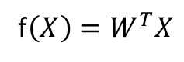
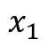
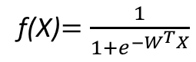
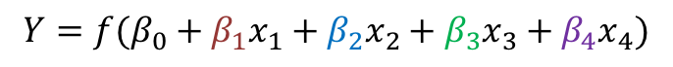
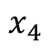
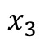
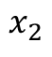
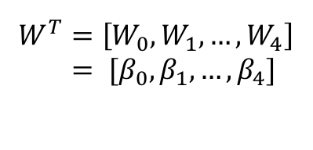
But what is the idea?
Start with Regression or Logistic Regression
Classification
Regression
f(X)$=\frac{1}{{1+e}^{−W^{T}X}}$
f$\left(X\right)=W^{T}X$
$$W^{T}=\left[W_{0},W_{1},…, W_{4}\right]$$
$= [β_{0}, β_{1},…, β_{4}]$
$$x_{1}$$
$$x_{2}$$
$$Y=f(β_{0}+β_{1}x_{1}+β_{2}x_{2}+β_{3}x_{3}+β_{4}x_{4})$$
$$x_{3}$$
$$x_{4}$$
Intercept or Bias
Coefficients or Weights

Slide 15
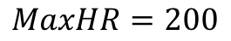
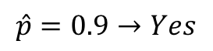
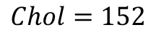
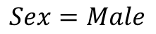
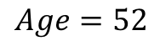
But what is the idea?
Start with all randomly selected weights. Most likely it will perform horribly.
For example, in our heart data, the model will be giving us the wrong answer.
$$MaxHR=200$$
$$Age=52$$
Correct answer
$$\hat{p}=0.9→Yes$$
y=No
$$Sex=Male$$
$$Chol=152$$
Bad Computer

Slide 16
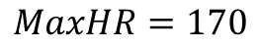
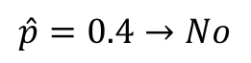
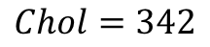
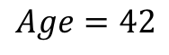
But what is the idea?
Start with all randomly selected weights. Most likely it will perform horribly.
For example, in our heart data, the model will be giving us the wrong answer.
$$MaxHR=170$$
$$Age=42$$
Correct answer
$$\hat{p}=0.4→No$$
y=Yes
$$Sex=Male$$
$$Chol=342$$
Bad Computer

Slide 17
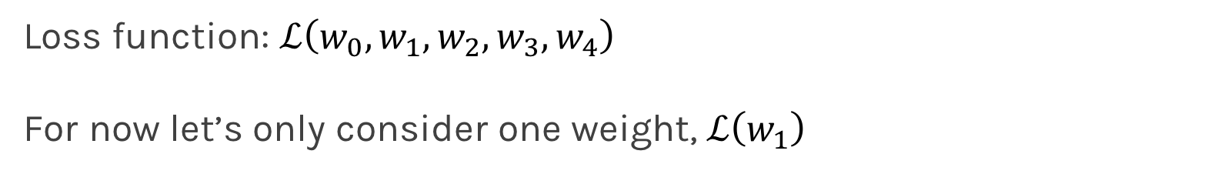
But what is the idea?
Loss Function: Takes all of these results and averages them and tells us how bad or good the computer or those weights are.
Telling the computer how bad or good is, does not help.
You want to tell it how to change those weights so it gets better.
Loss function: $ℒ\left(w_{0},w_{1},w_{2},w_{3},w_{4}\right)$
For now let’s only consider one weight, $ℒ\left(w_{1}\right)$

Slide 18
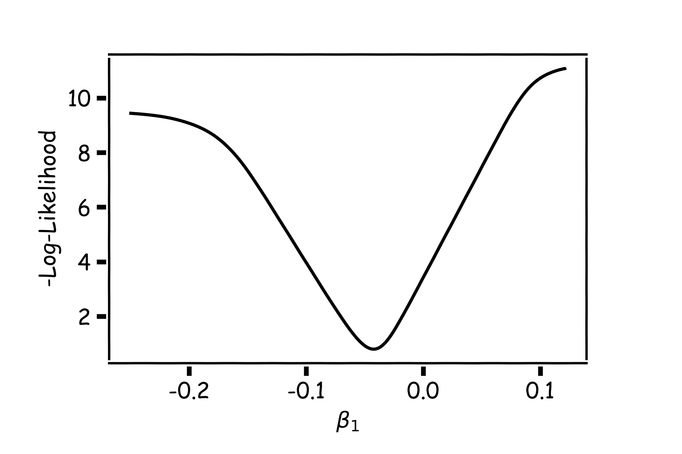
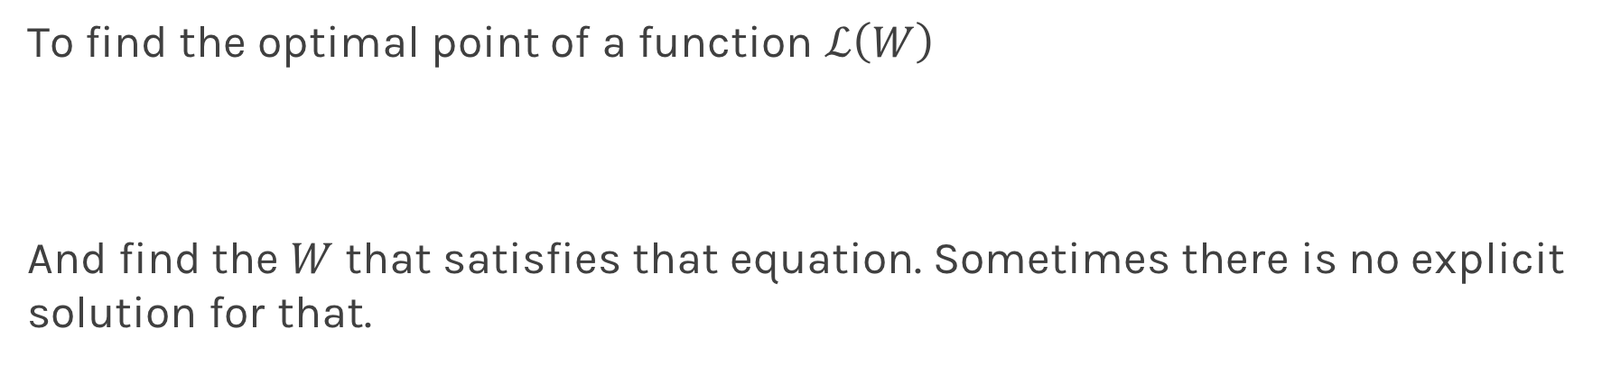
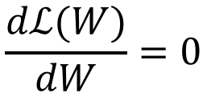
Minimizing the Loss function
Ideally we want to know the value of $w_{1}$ that gives the minimul $ℒ\left(W\right)$
To find the optimal point of a function $ℒ\left(W\right)$
And find the $W$ that satisfies that equation. Sometimes there is no explicit solution for that.
$$\frac{dℒ(W)}{dW}=0$$

Slide 19
Minimizing the Loss function
A more flexible method is
Start from any point
Determine which direction to go to reduce the loss (left or right)
Specifically, we can calculate the slope of the function at this point
Shift to the right if slope is negative or shift to the left if slope is positive
Repeat

Slide 20
Minimization of the Loss Function
If the step is proportional to the slope then you avoid overshooting the minimum.
Question: What is the mathematical function that describes the slope?
Question: How do we generalize this to more than one predictor?
Question: What do you think it is a good approach for telling the model how to change (what is the step size) to become better?

Slide 21
Minimization of the Loss Function
If the step is proportional to the slope then you avoid overshooting the minimum.
Question: What is the mathematical function that describes the slope? Derivative
Question: How do we generalize this to more than one predictor?
Take the derivative with respect to each coefficient and do the same sequentially
Question: What do you think it is a good approach for telling the model how to change (what is the step size) to become better?
More on this later

Slide 22
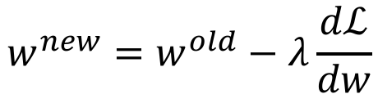
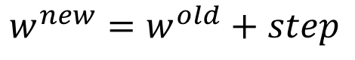
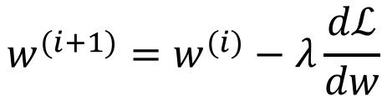
Let’s play the Pavlos game
We know that we want to go in the opposite direction of the derivative and we know we want to be making a step proportionally to the derivative.
Making a step means:
Learning Rate
$${w^{new}=w}^{old}+step$$
Opposite direction of the derivative means:
$${w^{new}=w}^{old}−λ\frac{dℒ}{dw}$$
Change to more conventional notation:
$${w^{(i+1)}=w}^{(i)}−λ\frac{dℒ}{dw}$$

Slide 23
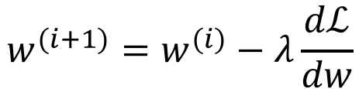
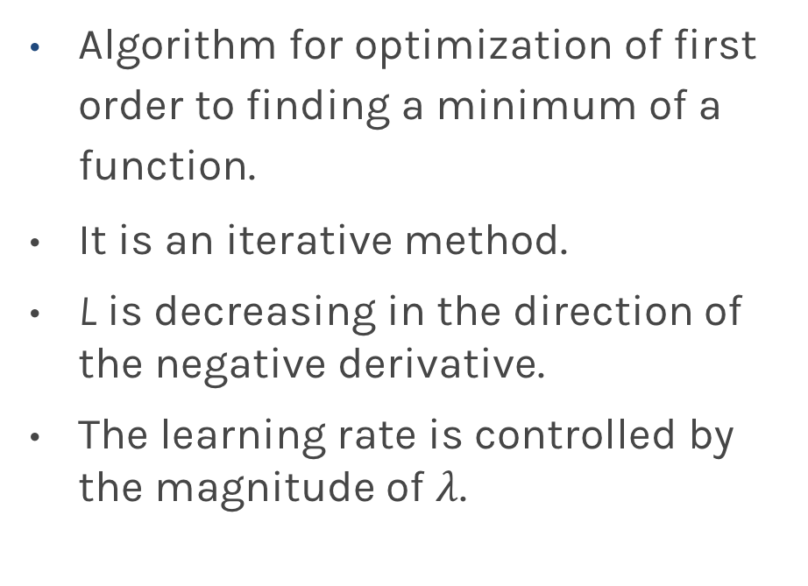
Gradient Descent
Algorithm for optimization of first order to finding a minimum of a function.
It is an iterative method.
L is decreasing in the direction of the negative derivative.
The learning rate is controlled by the magnitude of $λ$.
$${w^{(i+1)}=w}^{(i)}−λ\frac{dℒ}{dw}$$
L
-
+
w

Slide 24
Considerations
We still need to derive the derivatives.
We need to know what is the learning rate or how to set it.
We need to avoid local minima.
Finally, the full likelihood function includes summing up all individual ‘errors’. Unless you are a statistician, this can be hundreds of thousands of examples.

Slide 25
Considerations
We still need to derive the derivatives.
We need to know what is the learning rate or how to set it.
We need to avoid local minima.
Finally, the full likelihood function includes summing up all individual ‘errors’. Unless you are a statistician, this can be hundreds of thousands of examples.

Slide 26
Derivatives: Memories from middle school

Slide 27
Linear Regression

Slide 28
Logistic Regression Derivatives
Can we do it?
Wolfram Alpha can do it for us!
We need a formalism to deal with these derivatives.

Slide 29
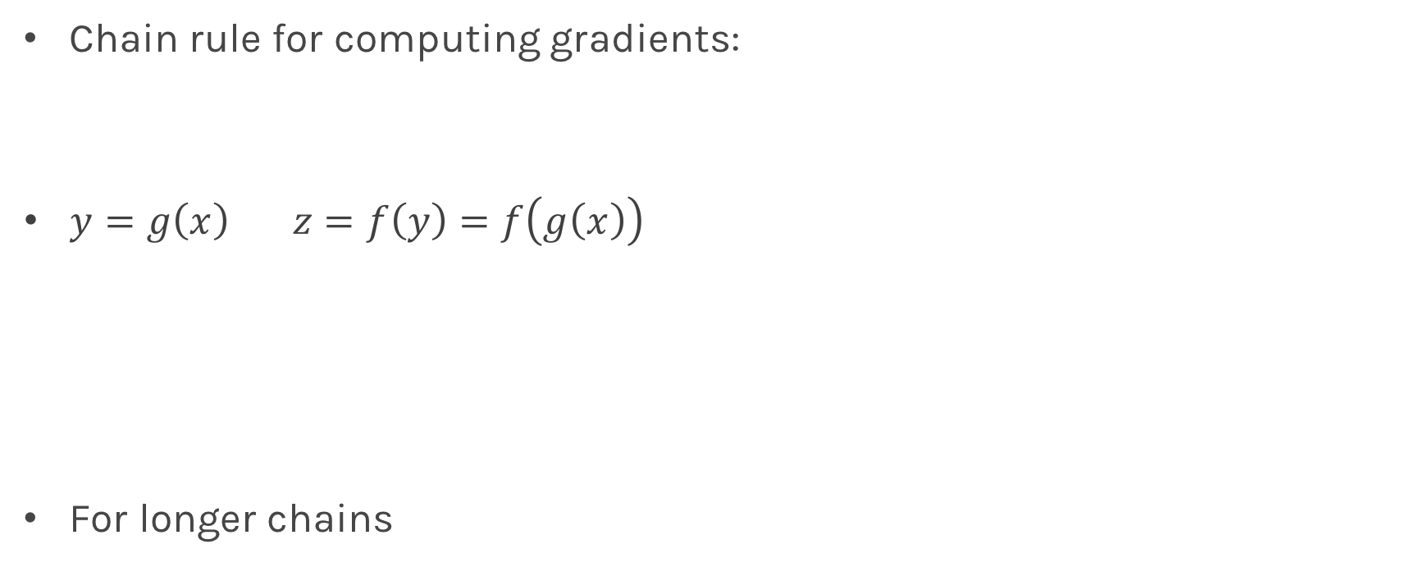
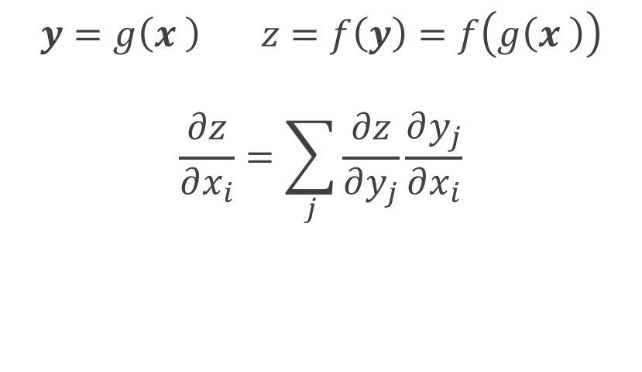
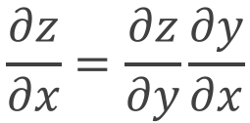
Chain Rule
Chain rule for computing gradients:
$y=g\left(x\right) z=f\left(y\right)=f\left(g\left(x\right)\right)$
For longer chains
$$y=g\left(x \right) z=f\left(y\right)=f\left(g\left(x \right)\right)$$
$$\frac{∂z}{∂x_{i}}=\sum_{j}{\frac{∂z}{∂y_{j}}\frac{∂y_{j}}{∂x_{i}}}$$
$$\frac{∂z}{∂x}=\frac{∂z}{∂y}\frac{∂y}{∂x}$$

Slide 30
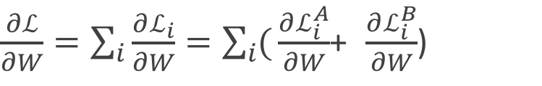
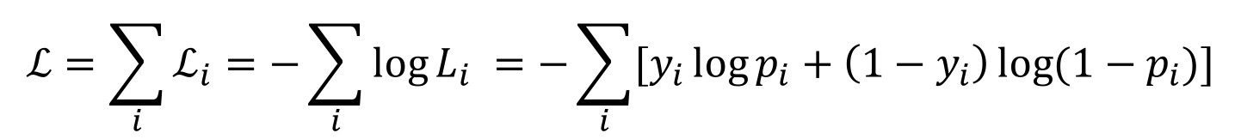
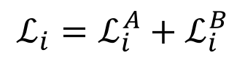
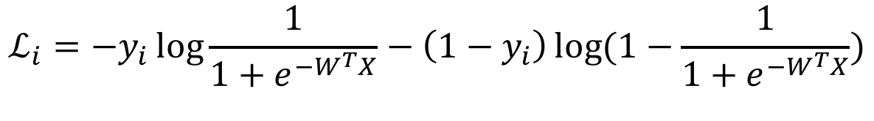
Logistic Regression derivatives
For logistic regression, the –ve log of the likelihood is:
$$ℒ=\sum_{i}{ℒ_{i}}=−\sum_{i}{\log{L_{i}}}{=−\sum_{i}{[y_{i}\log{p_{i}+\left(1−y_{i}\right)\log{(1−p_{i})]}}}}$$
$$ℒ_{i}={−y}_{i}\log{\frac{1}{1+e^{−W^{T}X}}−\left(1−y_{i}\right)\log{(1−\frac{1}{1+e^{−W^{T}X}})}}$$
To simplify the analysis let us split it into two parts,
$$ℒ_{i}=ℒ_{i}^{A}+ℒ_{i}^{B}$$
So the derivative with respect to W is:
$\frac{∂ℒ}{∂W}=\sum_{i}{\frac{∂ℒ_{i}}{∂W}}=\sum_{i}{(}\frac{∂ℒ_{i}^{A}}{∂W}$+ $\frac{∂ℒ_{i}^{B}}{∂W}$)

Slide 31
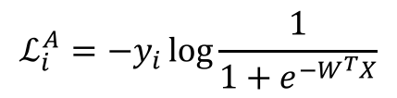
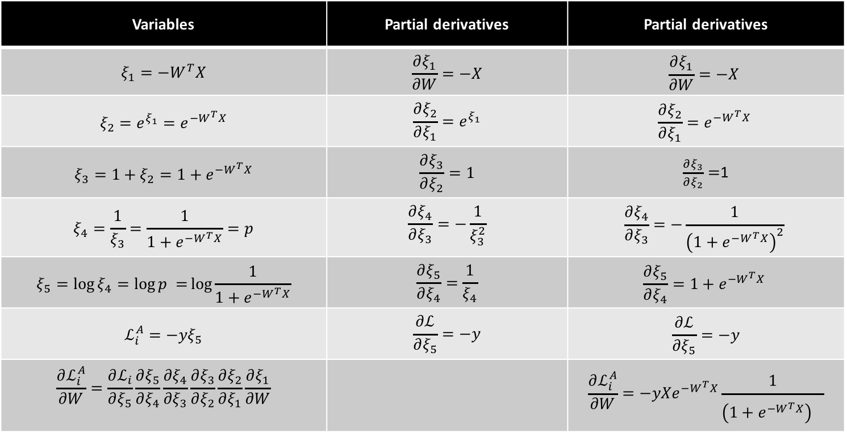
$$ℒ_{i}^{A}={−y}_{i}\log{\frac{1}{1+e^{−W^{T}X}}}$$
Variables | Partial derivatives | Partial derivatives
$$ξ_{1}=−W^{T}X$$ | $$\frac{∂ξ_{1}}{∂W}=−X$$ | $$\frac{∂ξ_{1}}{∂W}=−X$$
$$ξ_{2}={e^{ξ_{1}}=e}^{−W^{T}X}$$ | $$\frac{∂ξ_{2}}{∂ξ_{1}}=e^{ξ_{1}}$$ | $$\frac{∂ξ_{2}}{∂ξ_{1}}=e^{−W^{T}X}$$
$$ξ_{3}=1+ξ_{2}=1+e^{−W^{T}X}$$ | $$\frac{∂ξ_{3}}{∂ξ_{2}}=1$$ | $\frac{∂ξ_{3}}{∂ξ_{2}}=$1
$$ξ_{4}=\frac{1}{ξ_{3}}=\frac{1}{1+e^{−W^{T}X}}=p$$ | $$\frac{∂ξ_{4}}{∂ξ_{3}}=−\frac{1}{ξ_{3}^{2}}$$ | $$\frac{∂ξ_{4}}{∂ξ_{3}}=−\frac{1}{{\left(1+e^{−W^{T}X}\right)}^{2}}$$
$$ξ_{5}=\log{ξ_{4}=\log{p =}\log{\frac{1}{1+e^{−W^{T}X}}}}$$ | $$\frac{∂ξ_{5}}{∂ξ_{4}}=\frac{1}{ξ_{4}}$$ | $$\frac{∂ξ_{5}}{∂ξ_{4}}=1+e^{−W^{T}X}$$
$$ℒ_{i}^{A}=−yξ_{5}$$ | $$\frac{∂ℒ}{∂ξ_{5}}=−y$$ | $$\frac{∂ℒ}{∂ξ_{5}}=−y$$
$$\frac{∂ℒ_{i}^{A}}{∂W}=\frac{∂ℒ_{i}}{∂ξ_{5}}\frac{∂ξ_{5}}{∂ξ_{4}}\frac{∂ξ_{4}}{∂ξ_{3}}\frac{∂ξ_{3}}{∂ξ_{2}}\frac{∂ξ_{2}}{∂ξ_{1}}\frac{∂ξ_{1}}{∂W}$$ |  | $${\frac{∂ℒ_{i}^{A}}{∂W}=−yXe}^{−W^{T}X}\frac{1}{{\left(1+e^{−W^{T}X}\right)}^{}}$$

Slide 32
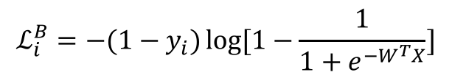
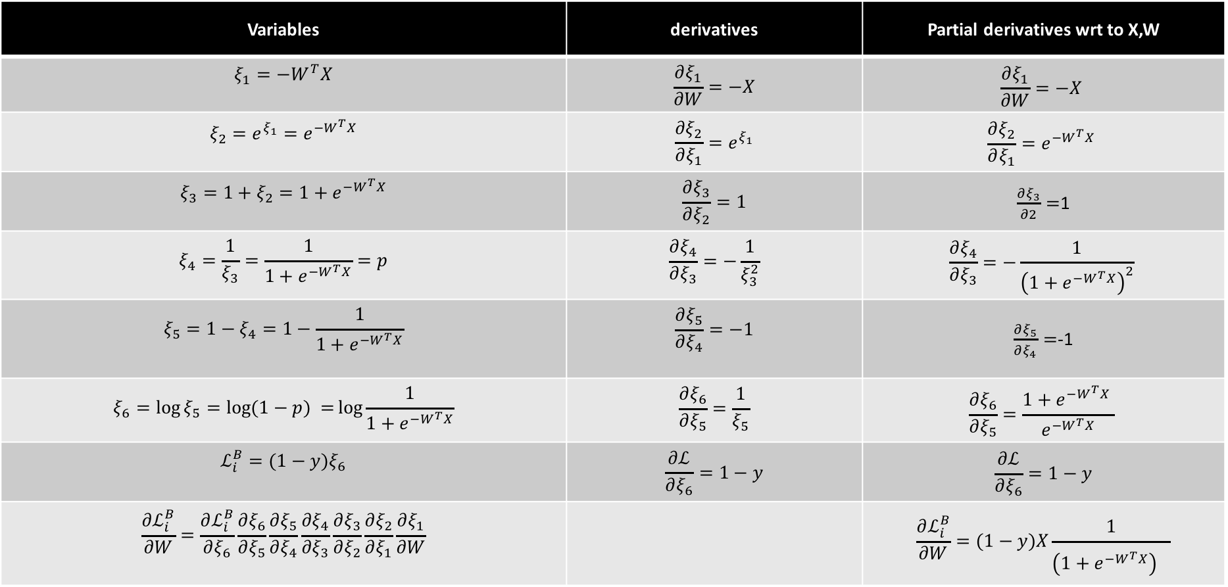
$$ℒ_{i}^{B}={−(1−y}_{i})\log{[1−\frac{1}{1+e^{−W^{T}X}}]}$$
Variables | derivatives | Partial derivatives wrt to X,W
$$ξ_{1}=−W^{T}X$$ | $$\frac{∂ξ_{1}}{∂W}=−X$$ | $$\frac{∂ξ_{1}}{∂W}=−X$$
$$ξ_{2}={e^{ξ_{1}}=e}^{−W^{T}X}$$ | $$\frac{∂ξ_{2}}{∂ξ_{1}}=e^{ξ_{1}}$$ | $$\frac{∂ξ_{2}}{∂ξ_{1}}=e^{−W^{T}X}$$
$$ξ_{3}=1+ξ_{2}=1+e^{−W^{T}X}$$ | $$\frac{∂ξ_{3}}{∂ξ_{2}}=1$$ | $\frac{∂ξ_{3}}{∂2}=$1
$$ξ_{4}=\frac{1}{ξ_{3}}=\frac{1}{1+e^{−W^{T}X}}=p$$ | $$\frac{∂ξ_{4}}{∂ξ_{3}}=−\frac{1}{ξ_{3}^{2}}$$ | $$\frac{∂ξ_{4}}{∂ξ_{3}}=−\frac{1}{{\left(1+e^{−W^{T}X}\right)}^{2}}$$
$$ξ_{5}=1−ξ_{4}=1−\frac{1}{1+e^{−W^{T}X}}$$ | $$\frac{∂ξ_{5}}{∂ξ_{4}}=−1$$ | $\frac{∂ξ_{5}}{∂ξ_{4}}=$-1
$$ξ_{6}=\log{ξ_{5}=\log{(1−p) =}\log{\frac{1}{1+e^{−W^{T}X}}}}$$ | $$\frac{∂ξ_{6}}{∂ξ_{5}}=\frac{1}{ξ_{5}}$$ | $$\frac{∂ξ_{6}}{∂ξ_{5}}=\frac{1+e^{−W^{T}X} }{e^{−W^{T}X}}$$
$$ℒ_{i}^{B}=(1−y)ξ_{6}$$ | $$\frac{∂ℒ}{∂ξ_{6}}=1−y$$ | $$\frac{∂ℒ}{∂ξ_{6}}=1−y$$
$$\frac{∂ℒ_{i}^{B}}{∂W}=\frac{∂ℒ_{i}^{B}}{∂ξ_{6}}\frac{∂ξ_{6}}{∂ξ_{5}}\frac{∂ξ_{5}}{∂ξ_{4}}\frac{∂ξ_{4}}{∂ξ_{3}}\frac{∂ξ_{3}}{∂ξ_{2}}\frac{∂ξ_{2}}{∂ξ_{1}}\frac{∂ξ_{1}}{∂W}$$ |  | $$\frac{∂ℒ_{i}^{B}}{∂W}=(1−y)X\frac{1}{{\left(1+e^{−W^{T}X}\right)}^{}}$$

Slide 33
Learning Rate

Slide 34
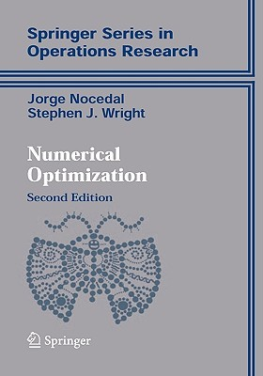
Learning Rate
Trial and Error.
There are many alternative methods which address how to set or adjust the learning rate, using the derivative or second derivatives and or the momentum. To be discussed in the next lectures on NN.
J. Nocedal y S. Wright, “Numerical optimization”, Springer, 1999 🔗
TLDR: J. Bullinaria, “Learning with Momentum, Conjugate Gradient Learning”, 2015 🔗

Slide 35
Local and Global minima

Slide 36
Local vs Global Minima
L
𝛉

Slide 37
Local vs Global Minima
L
𝛉

Slide 38
Local vs Global Minima
No guarantee that we get the global minimum.
Question: What would be a good strategy?

Slide 39
Large data

Slide 40
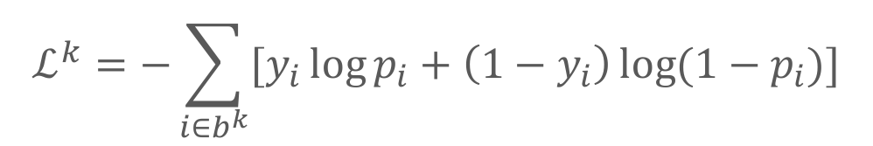
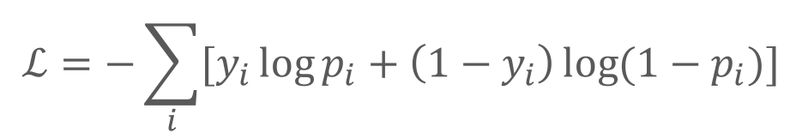
Batch and Stochastic Gradient Descent
$$ℒ=−\sum_{i}{[y_{i}\log{p_{i}+\left(1−y_{i}\right)\log{(1−p_{i})]}}}$$
Instead of using all the examples for every step, use a subset of them (batch).
For each iteration k, use the following loss function to derive the derivatives:
which is an approximation to the full Loss function.
$$ℒ^{k}=−\sum_{i∈b^{k}}{[y_{i}\log{p_{i}+\left(1−y_{i}\right)\log{(1−p_{i})]}}}$$

Slide 41
Batch and Stochastic Gradient Descent
Full Likelihood:
L
Batch Likelihood:
𝛉

Slide 42
Batch and Stochastic Gradient Descent
Full Likelihood:
L
Batch Likelihood:
𝛉

Slide 43
Batch and Stochastic Gradient Descent
Full Likelihood:
L
Batch Likelihood:
𝛉

Slide 44
Batch and Stochastic Gradient Descent
Full Likelihood:
L
Batch Likelihood:
𝛉

Slide 45
Batch and Stochastic Gradient Descent
Full Likelihood:
L
Batch Likelihood:
𝛉

Slide 46
Batch and Stochastic Gradient Descent
Full Likelihood:
L
Batch Likelihood:
𝛉

Slide 47
Batch and Stochastic Gradient Descent
Full Likelihood:
L
Batch Likelihood:
𝛉

Slide 48
Batch and Stochastic Gradient Descent
Full Likelihood:
L
Batch Likelihood:
𝛉

Slide 49
Batch and Stochastic Gradient Descent
Full Likelihood:
L
Batch Likelihood:
𝛉

Slide 50
Artificial Neural Networks (ANN)

Slide 51












Logistic Regression Revisited
Affine
Activation
Loss Fun
$$p_{i}=\frac{1}{1+e^{−h_{i}}}$$
$$x_{i}$$
$$h_{i}=β_{0}+β_{1}x_{i}$$
$$ℒ_{i}\left(β\right)=−y_{i}\ln\left(p_{i}\right)−\left(1−y_{i}\right)ln⁡(1−p_{i})$$
Affine
Activation
Loss Fun
$$p_{i}=\frac{1}{1+e^{−h_{k}}}$$
$$x_{k}$$
$$h_{k}=β_{0}+β_{1}x_{k}$$
$$ℒ_{k}\left(β\right)=−y_{k}\ln\left(p_{k}\right)−\left(1−y_{k}\right)ln⁡(1−p_{k})$$
…
Affine
Activation
Loss Fun
$$ℒ(β)=\sum_{i}^{n}{ℒ_{i}\left(β\right)}$$
$$p=\frac{1}{1+e^{−h}}$$
$$X$$
$$h=β_{0}+β_{1}X$$

Slide 52











Build our first ANN
Affine
Activation
Loss Fun
$$ℒ(β)=\sum_{i}^{n}{ℒ_{i}\left(β\right)}$$
$$p=\frac{1}{1+e^{−h}}$$
$$X$$
$$h=β_{0}+β_{1}X$$
Affine
Activation
Loss Fun
$$ℒ(β)=\sum_{i}^{n}{ℒ_{i}\left(β\right)}$$
$$p=\frac{1}{1+e^{−h}}$$
$$X$$
$$h=β^{T}X$$
Affine
Activation
Loss Fun
$$ℒ(W)=\sum_{i}^{n}{ℒ_{i}\left(W\right)}$$
$$y=\frac{1}{1+e^{−h}}$$
$$X$$
$$h=W^{T}X$$

Slide 53





Build our first ANN
Affine
Activation
Loss Fun
$$ℒ(W)=\sum_{i}^{n}{ℒ_{i}\left(W\right)}$$
$$p=\frac{1}{1+e^{−h}}$$
$$X$$
$$h=W^{T}X$$
$$X$$
$$Y$$
Single Neuron Network
Very similar to Perceptron

Slide 54


Example Using Heart Data
Slightly modified data to illustrate a concept.

Slide 55



Example Using Heart Data
$$X$$
$$Y$$

Slide 56






Example
$$X$$
$$Y$$
$$X$$
$$Y’$$

Slide 57








Pavlos game #232
W₁
W₁
$$X$$
$$Y$$
$$h_{1}$$
$$h_{1}+h_{2}$$
$$X$$
W₂
W₂
$$h_{2}$$
$$X$$
$$Y′$$

Slide 58


Pavlos game #232
$$q= W_{31}h_{1}+{W_{32}h}_{2}+W_{30}$$
W₁
W₁
$$X$$
$$Y$$
$$h_{1}$$
$$W_{3}$$
$$X$$
W₂
W₂
$$h_{2}$$
$$X$$
$$Y$$

Slide 59



Pavlos game #232
$$q= W_{31}h_{1}+{W_{32}h}_{2}+W_{30}$$
$$p=\frac{1}{1+e^{−q}}$$
W₁
W₁
$$X$$
$$Y$$
$$h_{1}$$
$$W_{3}$$
$$X$$
W₂
W₂
$$h_{2}$$
$$X$$
$$Y$$
$$L=−y ln\left(p\right)−\left(1−y\right)ln(1−p)$$
Need to learn W1, W2 and W3.

Slide 60
Backpropagation

Slide 61








Backpropagation: Logistic Regression Revisited
Affine
Activation
Loss Fun
$$ℒ(β)=\sum_{i}^{n}{ℒ_{i}\left(β\right)}$$
$$p=\frac{1}{1+e^{−h}}$$
$$X$$
$$h=β_{0}+β_{1}X$$
$\frac{∂ℒ}{∂p}$ $\frac{∂p}{∂h}$ $\frac{∂h}{∂β}$
$\frac{∂ℒ}{∂p}$ $\frac{∂p}{∂h}$
$$\frac{∂ℒ}{∂p}$$
$$\frac{∂h}{∂β_{1}}=X,\frac{dℒ}{dβ_{0}}=1$$
$$\frac{∂p}{∂h}=σ(h)(1−σ\left(h\right))$$
$$\frac{∂ℒ}{∂p}=−y\frac{1}{p}−\left(1−y\right)\frac{1}{1−p}$$
$$\frac{∂ℒ}{∂β_{1}}=−Xσ\left(h\right)\left(1−σ\left(h\right)\right)[y\frac{1}{p}+\left(1−y\right)\frac{1}{1−p}]$$
$$\frac{∂ℒ}{∂β_{0 }}=−σ\left(h\right)\left(1−σ\left(h\right)\right)[ y\frac{1}{p}+\left(1−y\right)\frac{1}{1−p}]$$
Notes:
Find loss with respect to the derivative
Find the derivative of the loss function with respect to the weights, the gradient,

Slide 62



Backpropagation
Derivatives need to be evaluated at some values of X,y and W.
But since we have an expression, we can build a function that takes as input X,y,W and returns the derivatives and then we can use gradient descent to update.
This approach works well but it does not generalize. For example if the network is changed, we need to write a new function to evaluate the derivatives.
For example this network will need a different function for the derivatives
W₁
$$W_{3}$$
$$X$$
$$Y$$
W₂

Slide 63





Backpropagation
Derivatives need to be evaluated at some values of X,y and W.
But since we have an expression, we can build a function that takes as input X,y,W and returns the derivatives and then we can use gradient descent to update.
This approach works well but it does not generalize. For example if the network is changed, we need to write a new function to evaluate the derivatives.
For example this network will need a different function for the derivatives
W₁
$$W_{3}$$
$$W_{5}$$
$$X$$
$$Y$$
W₂
$$W_{4}$$

Slide 64

Backpropagation. Pavlos game #456
Need to find a formalism to calculate the derivatives of the loss wrt to weights that is:
Flexible enough that adding a node or a layer or changing something in the network won’t require to re-derive the functional form from scratch.
It is exact.
It is computationally efficient.
Hints:
Remember we only need to evaluate the derivatives at $X_{i}, y_{i}$ and $W^{(k)}.$
We should take advantage of the chain rule we learned before

Slide 65

Idea 1: Evaluate the derivative at: X={3}, y=1, W=3
Variables | derivatives | Value of the variable | Value of the partial derivative | $$\frac{dξ_{n}}{dW}$$
$$ξ_{1}=−W^{T}X$$ | $$\frac{∂ξ_{1}}{∂W}=−X$$ | $$−9$$ | -3 | -3
$$ξ_{2}={e^{ξ_{1}}=e}^{−W^{T}X}$$ | $$\frac{∂ξ_{2}}{∂ξ_{1}}=e^{ξ_{1}}$$ | $$e^{−9}$$ | $$e^{−9}$$ | -3$e^{−9}$
$$ξ_{3}=1+ξ_{2}=1+e^{−W^{T}X}$$ | $$\frac{∂ξ_{3}}{∂ξ_{2}}=1$$ | 1+$e^{−9}$ | 1 | -3$e^{−9}$
$$ξ_{4}=\frac{1}{ξ_{3}}=\frac{1}{1+e^{−W^{T}X}}=p$$ | $$\frac{∂ξ_{4}}{∂ξ_{3}}=−\frac{1}{ξ_{3}^{2}}$$ | $$\frac{1}{1+e^{−9}}$$ | $${\left(\frac{1}{1+e^{−9}}\right)}^{2}$$ | -3$e^{−9}{\left(\frac{1}{1+e^{−9}}\right)}^{2}$
$$ξ_{5}=\log{ξ_{4}=\log{p =}\log{\frac{1}{1+e^{−W^{T}X}}}}$$ | $$\frac{∂ξ_{5}}{∂ξ_{4}}=\frac{1}{ξ_{4}}$$ | $$\log{\frac{1}{1+e^{−9}}}$$ | $$1+e^{−9}$$ | -3$e^{−9}{\left(\frac{1}{1+e^{−9}}\right)}^{}$
$$ℒ_{i}^{A}=−yξ_{5}$$ | $$\frac{∂ℒ}{∂ξ_{5}}=−y$$ | $$−\log{\frac{1}{1+e^{−9}}}$$ | $$−1$$ | 3$e^{−9}{\left(\frac{1}{1+e^{−9}}\right)}^{}$
$$\frac{∂ℒ_{i}^{A}}{∂W}=\frac{∂ℒ_{i}}{∂ξ_{5}}\frac{∂ξ_{5}}{∂ξ_{4}}\frac{∂ξ_{4}}{∂ξ_{3}}\frac{∂ξ_{3}}{∂ξ_{2}}\frac{∂ξ_{2}}{∂ξ_{1}}\frac{∂ξ_{1}}{∂W}$$ |  |  | $$−3$$ | 0.00037018372

Slide 66

Basic functions
We still need to derive derivatives ☹
Variables | derivatives | Value of the variable | Value of the partial derivative | $$\frac{dξ_{n}}{dW}$$
$$ξ_{1}=−W^{T}X$$ | $$\frac{∂ξ_{1}}{∂W}=−X$$ | $$−9$$ | -3 | -3
$$ξ_{2}={e^{ξ_{1}}=e}^{−W^{T}X}$$ | $$\frac{∂ξ_{2}}{d∂ξ_{1}}=e^{ξ_{1}}$$ | $$e^{−9}$$ | $$e^{−9}$$ | -3$e^{−9}$
$$ξ_{3}=1+ξ_{2}=1+e^{−W^{T}X}$$ | $$\frac{∂ξ_{3}}{∂ξ_{2}}=1$$ | 1+$e^{−9}$ | 1 | -3$e^{−9}$
$$ξ_{4}=\frac{1}{ξ_{3}}=\frac{1}{1+e^{−W^{T}X}}=p$$ | $$\frac{∂ξ_{4}}{∂ξ_{3}}=−\frac{1}{ξ_{3}^{2}}$$ | $$\frac{1}{1+e^{−9}}$$ | $${\left(\frac{1}{1+e^{−9}}\right)}^{2}$$ | -3$e^{−9}{\left(\frac{1}{1+e^{−9}}\right)}^{2}$
$$ξ_{5}=\log{ξ_{4}=\log{p =}\log{\frac{1}{1+e^{−W^{T}X}}}}$$ | $$\frac{∂ξ_{5}}{∂ξ_{4}}=\frac{1}{ξ_{4}}$$ | $$\log{\frac{1}{1+e^{−9}}}$$ | $$1+e^{−9}$$ | -3$e^{−9}{\left(\frac{1}{1+e^{−9}}\right)}^{}$
$$ℒ_{i}^{A}=−yξ_{5}$$ | $$\frac{∂ℒ}{∂ξ_{5}}=−y$$ | $$−\log{\frac{1}{1+e^{−9}}}$$ | $$−1$$ | 3$e^{−9}{\left(\frac{1}{1+e^{−9}}\right)}^{}$
$$\frac{∂ℒ_{i}^{A}}{∂W}=\frac{∂ℒ_{i}}{∂ξ_{5}}\frac{∂ξ_{5}}{∂ξ_{4}}\frac{∂ξ_{4}}{∂ξ_{3}}\frac{∂ξ_{3}}{∂ξ_{2}}\frac{∂ξ_{2}}{∂ξ_{1}}\frac{∂ξ_{1}}{∂W}$$ |  |  | $$−3$$ | 0.00037018372

Slide 67

Basic functions
Notice though those are basic functions that my grandparent can do
$$ξ_{0}=X$$ | $$\frac{∂ξ_{0}}{∂X}=1$$ | def x0(x): return X | def derx0(): return 1
$$ξ_{1}=−W^{T}ξ_{0}$$ | $$\frac{∂ξ_{1}}{∂W}=−X$$ | def x1(a,x): return –a*X | def derx1(a,x): return -a
$$ξ_{2}=e^{ξ_{1}}$$ | $$\frac{∂ξ_{2}}{∂ξ_{1}}=e^{ξ_{1}}$$ | def x2(x): return np.exp(x) | def derx2(x): return np.exp(x)
$$ξ_{3}=1+ξ_{2}$$ | $$\frac{∂ξ_{3}}{∂ξ_{2}}=1$$ | def x3(x): return 1+x | def derx3(x): return 1
$$ξ_{4}=\frac{1}{ξ_{3}}$$ | $$\frac{∂ξ_{4}}{∂ξ_{3}}=−\frac{1}{ξ_{3}^{2}}$$ | def der1(x): return 1/(x) | def derx4(x): return -(1/x)**(2)
$$ξ_{5}=\log{ξ_{4}}$$ | $$\frac{∂ξ_{5}}{∂ξ_{4}}=\frac{1}{ξ_{4}}$$ | def der1(x): return np.log(x) | def derx5(x) return 1/x
$$ℒ_{i}^{A}=−yξ_{5}$$ | $$\frac{∂ℒ}{∂ξ_{5}}=−y$$ | def der1(y,x): return –y*x | def derL(y): return -y

Slide 68


Putting it altogether
1. We specify the network structure
W₁
$$W_{3}$$
$$X$$
$$W_{5}$$
$$Y$$
W₂
$$W_{4}$$
2. We create the computational graph …
What is computational graph?

Slide 69


















$$ξ_{5}=log{\frac{1}{1+e^{−W^{T}X}}}$$
Computational Graph
$$ξ_{4}=\frac{1}{1+e^{−W^{T}X}}$$
$$÷$$
Log
$$ξ_{7}=log(1−{\frac{1}{1+e^{−W^{T}X}})}$$
$$ξ_{3}={1+e}^{−W^{T}X}$$
$$+$$
log
-
1
$$exp$$
$$ξ_{6}=1−{\frac{1}{1+e^{−W^{T}X}}}$$
1-y
$$ξ_{2}=e^{−ξ_{1}} \\ ξ_{2}^{′}={−e}^{−ξ_{1}}$$
$$−$$
$$×$$
$$ξ_{1}=W^{T}X$$ $ξ_{1}^{′}$=X
y
$$×$$
$$×$$
$$ξ_{8}=\left(1−y\right)log(1−{\frac{1}{1+e^{−W^{T}X}})}$$
$$ξ_{9}=ylog({\frac{1}{1+e^{−W^{T}X}})}$$
W
X
$$+$$
$$ξ_{0}=W$$
$$−ℒ=ξ_{9}=ylog({\frac{1}{1+e^{−W^{T}X}})}+ \left(1−y\right)log(1−{\frac{1}{1+e^{−W^{T}X}})}$$

Slide 70
Putting it altogether
1. We specify the network structure
W₁
$$W_{3}$$
$$X$$
$$W_{5}$$
$$Y$$
W₂
$$W_{4}$$
We create the computational graph.
At each node of the graph we build two functions: the evaluation of the variable and its partial derivative with respect to the previous variable (as shown in the table 3 slides back)
Now we can either go forward or backward depending on the situation. In general, forward is easier to implement and to understand. The difference is clearer when there are multiple nodes per layer.

Slide 71

Forward mode: Evaluate the derivative at: X={3}, y=1, W=3
Variables | derivatives | Value of the variable | Value of the partial derivative | $$\frac{dℒ}{dξ_{n}}$$
$$ξ_{1}=−W^{T}X$$ | $$\frac{∂ξ_{1}}{∂W}=−X$$ | $$−9$$ | -3 | -3
$$ξ_{2}={e^{ξ_{1}}=e}^{−W^{T}X}$$ | $$\frac{∂ξ_{2}}{∂ξ_{1}}=e^{ξ_{1}}$$ | $$e^{−9}$$ | $$e^{−9}$$ | -3$e^{−9}$
$$ξ_{3}=1+ξ_{2}=1+e^{−W^{T}X}$$ | $$\frac{∂ξ_{3}}{∂ξ_{2}}=1$$ | 1+$e^{−9}$ | 1 | -3$e^{−9}$
$$ξ_{4}=\frac{1}{ξ_{3}}=\frac{1}{1+e^{−W^{T}X}}=p$$ | $$\frac{∂ξ_{4}}{∂ξ_{3}}=−\frac{1}{ξ_{3}^{2}}$$ | $$\frac{1}{1+e^{−9}}$$ | $${\left(\frac{1}{1+e^{−9}}\right)}^{2}$$ | -3$e^{−9}{\left(\frac{1}{1+e^{−9}}\right)}^{2}$
$$ξ_{5}=\log{ξ_{4}=\log{p =}\log{\frac{1}{1+e^{−W^{T}X}}}}$$ | $$\frac{∂ξ_{5}}{∂ξ_{4}}=\frac{1}{ξ_{4}}$$ | $$\log{\frac{1}{1+e^{−9}}}$$ | $$1+e^{−9}$$ | -3$e^{−9}{\left(\frac{1}{1+e^{−9}}\right)}^{}$
$$ℒ_{i}^{A}=−yξ_{5}$$ | $$\frac{∂ℒ}{∂ξ_{5}}=−y$$ | $$−\log{\frac{1}{1+e^{−9}}}$$ | $$−1$$ | 3$e^{−9}{\left(\frac{1}{1+e^{−9}}\right)}^{}$
$$\frac{∂ℒ_{i}^{A}}{∂W}=\frac{∂ℒ_{i}}{∂ξ_{5}}\frac{∂ξ_{5}}{∂ξ_{4}}\frac{∂ξ_{4}}{∂ξ_{3}}\frac{∂ξ_{3}}{∂ξ_{2}}\frac{∂ξ_{2}}{∂ξ_{1}}\frac{∂ξ_{1}}{∂W}$$ |  |  | $$−3$$ | 0.00037018372

Slide 72

Backward mode: Evaluate the derivative at: X={3}, y=1, W=3
Variables | derivatives | Value of the variable | Value of the partial derivative
$$ξ_{1}=−W^{T}X$$ | $$\frac{∂ξ_{1}}{∂W}=−X$$ | $$−9$$ | -3
$$ξ_{2}={e^{ξ_{1}}=e}^{−W^{T}X}$$ | $$\frac{∂ξ_{2}}{∂ξ_{1}}=e^{ξ_{1}}$$ | $$e^{−9}$$ | $$e^{−9}$$
$$ξ_{3}=1+ξ_{2}=1+e^{−W^{T}X}$$ | $$\frac{∂ξ_{3}}{∂ξ_{2}}=1$$ | 1+$e^{−9}$ | 1
$$ξ_{4}=\frac{1}{ξ_{3}}=\frac{1}{1+e^{−W^{T}X}}=p$$ | $$\frac{∂ξ_{4}}{∂ξ_{3}}=−\frac{1}{ξ_{3}^{2}}$$ | $$\frac{1}{1+e^{−9}}$$ | $${\left(\frac{1}{1+e^{−9}}\right)}^{2}$$
$$ξ_{5}=\log{ξ_{4}=\log{p =}\log{\frac{1}{1+e^{−W^{T}X}}}}$$ | $$\frac{∂ξ_{5}}{∂ξ_{4}}=\frac{1}{ξ_{4}}$$ | $$\log{\frac{1}{1+e^{−9}}}$$ | $$1+e^{−9}$$
$$ℒ_{i}^{A}=−yξ_{5}$$ | $$\frac{∂ℒ}{∂ξ_{5}}=−y$$ | $$−\log{\frac{1}{1+e^{−9}}}$$ | $$−1$$
$$\frac{∂ℒ_{i}^{A}}{∂W}=\frac{∂ℒ_{i}}{∂ξ_{5}}\frac{∂ξ_{5}}{∂ξ_{4}}\frac{∂ξ_{4}}{∂ξ_{3}}\frac{∂ξ_{3}}{∂ξ_{2}}\frac{∂ξ_{2}}{∂ξ_{1}}\frac{∂ξ_{1}}{∂W}$$
Store all these values

